Slide 1
Mathematics in Data Science
(MaDS)
T. J. Peters
University of Connecticut

Slide 2
Note Shift
1. Not: Mathematics of Big Data
2. Big Data is within a larger view of Data Science.
3. Data Science is the displine.
4. Big Data is some of the data.
5. Don Sheehy: `big enough data’

Slide 3
Why focus on mathematics?
1. Broad theoretical foundations.
2. Leads to sound, extensible software design.
3. Abstractions permit staying ahead of curve.
4. Unifies view to permit consolidations:
  Code
  Sectors: biology vs sports vs medicine.

Slide 4
ICERM Workshop 7/28/15
Providence, RI (with Brown)
Overview of 1 day of 3. https://icerm.brown.edu/topical_workshops/tw15-6-mds/
Abstracts, slides of talks
Videos to be posted

Slide 5
Big Data Visual Analysis
(Incredible!!)
Chris Johnson,
University of Utah

Slide 6
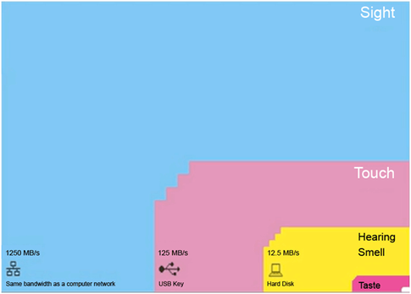
BANDWIDTH OF OUR SENSES
  Tor Norretranders
  http://www.quora.com/How-much-bandwidth-does-each-human-sense-consume-relatively-speaking

Slide 7
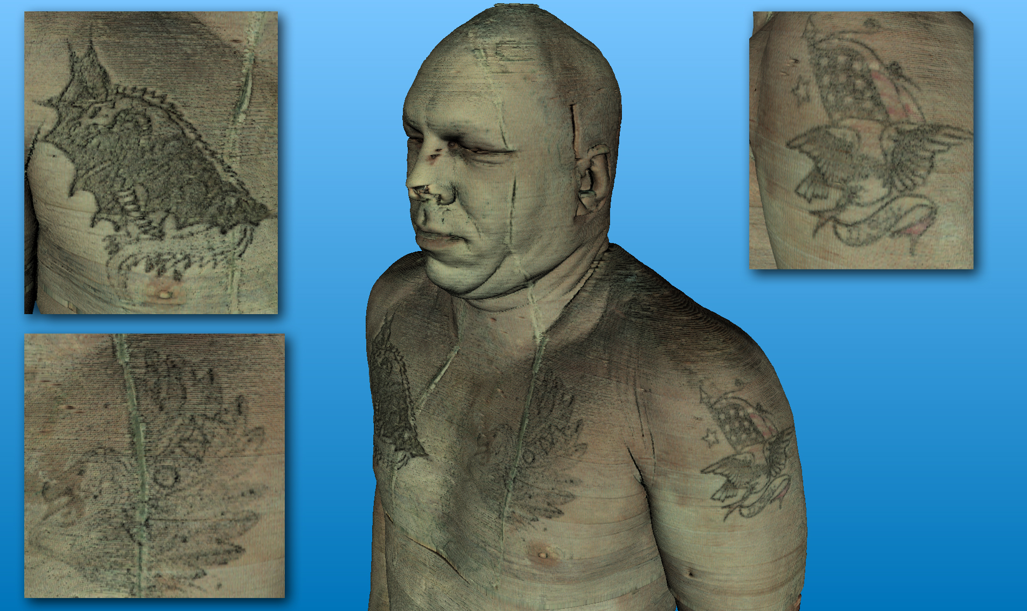
http://public.kitware.com/ImageVote2008/media/pollimages/vishuman.jpg

Slide 8
Tatoos and Size
“While we have used the visible human datasets in many applications over the last couple of years it was only recently that we are able to investigate the large color dataset at interactive rates on a single core commodity PC with a standard graphics card.”
“To our great surprise we discovered the body paintingsseen in the images in the 12 GB full resolution data.”

Slide 9
Size Matters
Question tatoos from a medical/scientific point of view
“Size does matter! I.e. small structures - such as these tattoos – which may also be some subtle organ anomalies may only become visible at the full resolution.”

Slide 10
Tatoos and Size
(Citations)
http://public.kitware.com/ImageVote2008/images/62/
http://www.sci.utah.edu/publications/Fog2009b/Fogal_IFMBE2009b.pdf
T. Fogal, J. Krüger. “Size Matters - Revealing Small Scale Structures in Large Datasets,” In Proceedings of the World Congress on Medical Physics and Biomedical Engineering, September 7 - 12, 2009, Munich, Germany, IFMBE Proceedings, Vol. 25/13, Springer Berlin Heidelberg, pp. 41--44. 2009.

Slide 11
Next Microscope
100 PB data sets for parts of brain
Integrate all
Visualize and analyze

Slide 12
Feature Generation for Drug Discovery Learning
(Potential!!)
(Topology—Study of Shape)
Anthony Bak,
Ayasdi, Inc.

Slide 13
Ayasdi
“Data has shape and shape has meaning.”
Gunnar Carlsson,
Ayasdi, Inc. & Stanford University

Slide 16
Mathematics
1. Finite metric spaces
(distances between points)
2 . Algebraic topology
3. Machine learning
4. Static graphics, moments in time.

Slide 17

www.bangor.ac.uk/cpm/sculmath/movimm.htm

Slide 18
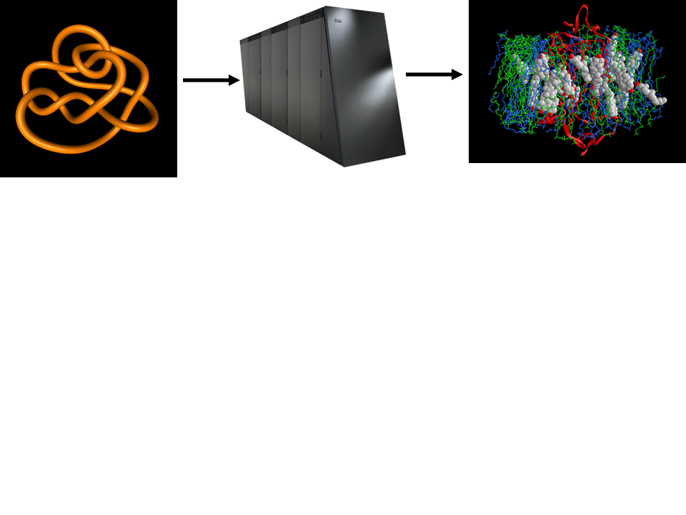
Knots, Molecules, Viz, Steering
T. J. Peters

Slide 19
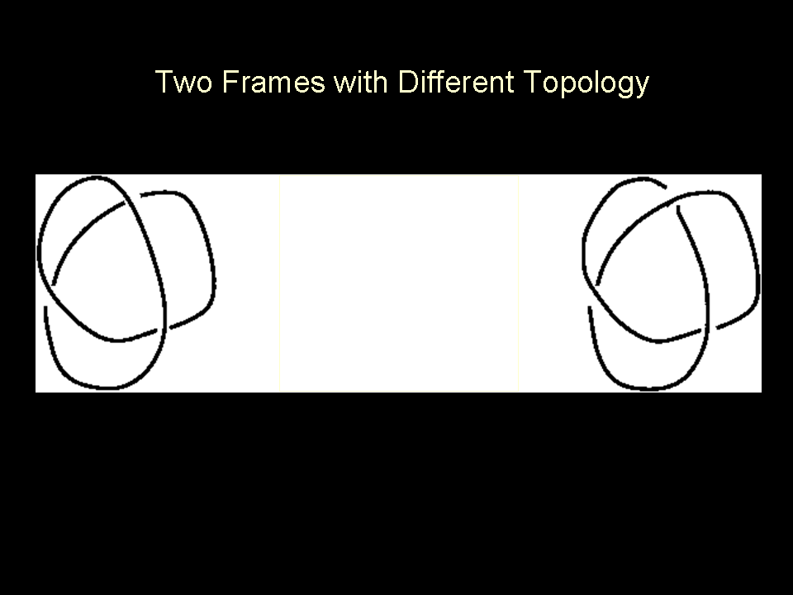
Knots, Molecules, Viz, Steering

Slide 20
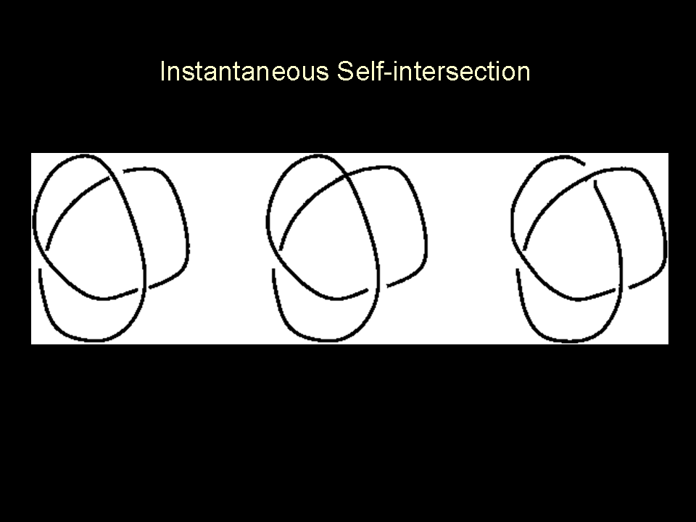

Knots, Molecules, Viz, Steering

Slide 21
Knots, Molecules, Viz, Steering

Slide 22
My Work
Petabytes generated by high performance computing simulations of molecular dynamics, particularly protein misfolding
2 . Topology (knot theory)
3. Algorithms for timely intersection detection
4. Dynamic viz, computational geometry, numerical analysis for precise viz for visual analytics.

Slide 23
3D Structure Determination using Cryo-Electron Microscopy - Computational Challenges
Amit Singer, Princeton University

Slide 24
[AS] Overview
3D reconstruction from partial 2D data.
2 Random rotations of 2D projections.
3. Phyics of electron potential vs infinitely many rotations.
4 Create surface.

Slide 25
Past methods
1.Estaimate iteratively, 90% solution.
2 But subject to bias of initial human guess.

Slide 26
Steps to Improvement
1. Formulation of Unique Games, Khot+, `05
2 Fourier projection slice, .
3. Search space is exponential & non-convex.

Slide 27
Insight
Planes intersecting in too many lines.
2. Fourier transform on a compact group.
3. Constrained search
4. MLE in polynomial time, with certificate.

Slide 28
Diamond Sampling for Approximate Maximum All-pairs Dot-product (MAD) Search (*)
Tammy Kolda, Sandia National Laboratories

Slide 29
[TK] Overview
1.Numerical Data Science.
2 MAD: Maximum All-pairs Dot-product Search.

Slide 30
Insight
Parallel list of options
Make a graph
3. Pick one, find a good pair (wedge). ^
4. Repeat, to get diamond, optimize.

Slide 31
National Science Foundation (NSF)
(seed funding to academia & industry)
Recent solicitation:
  http://www.nsf.gov/funding/pgm_summ.jsp?pims_id=504767
GOALI: Grant Opportunities for Academic Liaison with Industry
Possible source for early TT
Possibly bigger collaborations with NIH or DARPA

