Slide 1
Modeling Neurodevelopment for Infantile Hydrocephalus
  Thomas J. Peters
  University of Connecticut
  with
  J. C. Conover, D. McManus, K. Pratt,
  K.D. Williams, K. Kahle
  May 5, 2017
  Yale, Neurosurgery Grand Rounds

Slide 2
<?xml version="1.0"?><AllQuestions />
<?xml version="1.0"?><Settings><answerBulletFormat>Numeric</answerBulletFormat><answerNowAutoInsert>No</answerNowAutoInsert><answerNowStyle>Explosion</answerNowStyle><answerNowText>Answer Now</answerNowText><chartColors>Use PowerPoint Color Scheme</chartColors><chartType>Horizontal</chartType><correctAnswerIndicator>Checkmark</correctAnswerIndicator><countdownAutoInsert>No</countdownAutoInsert><countdownSeconds>10</countdownSeconds><countdownSound>TicToc.wav</countdownSound><countdownStyle>Box</countdownStyle><gridAutoInsert>No</gridAutoInsert><gridFillStyle>Answered</gridFillStyle><gridFillColor>0,0,0</gridFillColor><gridOpacity>100%</gridOpacity><gridTextStyle>Keypad #</gridTextStyle><inputSource>Response Devices</inputSource><multipleResponseDivisor># of Responses</multipleResponseDivisor><participantsLeaderBoard>5</participantsLeaderBoard><percentageDecimalPlaces>0</percentageDecimalPlaces><responseCounterAutoInsert>No</responseCounterAutoInsert><responseCounterStyle>Oval</responseCounterStyle><responseCounterDisplayValue># of Votes Received</responseCounterDisplayValue><insertObjectUsingColor>Blue</insertObjectUsingColor><showResults>Yes</showResults><teamColors>User Defined</teamColors><teamIdentificationType>None</teamIdentificationType><teamScoringType>Voting pads only</teamScoringType><teamScoringDecimalPlaces>1</teamScoringDecimalPlaces><teamIdentificationItem></teamIdentificationItem><teamsLeaderBoard>5</teamsLeaderBoard><teamName1></teamName1><teamName2></teamName2><teamName3></teamName3><teamName4></teamName4><teamName5></teamName5><teamName6></teamName6><teamName7></teamName7><teamName8></teamName8><teamName9></teamName9><teamName10></teamName10><showControlBar>Slides with Get Feedback Objects</showControlBar><defaultCorrectPointValue>100</defaultCorrectPointValue><defaultIncorrectPointValue>0</defaultIncorrectPointValue><chartColor1>187,224,227</chartColor1><chartColor2>51,51,153</chartColor2><chartColor3>0,153,153</chartColor3><chartColor4>153,204,0</chartColor4><chartColor5>128,128,128</chartColor5><chartColor6>0,0,0</chartColor6><chartColor7>0,102,204</chartColor7><chartColor8>204,204,255</chartColor8><chartColor9>255,0,0</chartColor9><chartColor10>255,255,0</chartColor10><teamColor1>187,224,227</teamColor1><teamColor2>51,51,153</teamColor2><teamColor3>0,153,153</teamColor3><teamColor4>153,204,0</teamColor4><teamColor5>128,128,128</teamColor5><teamColor6>0,0,0</teamColor6><teamColor7>0,102,204</teamColor7><teamColor8>204,204,255</teamColor8><teamColor9>255,0,0</teamColor9><teamColor10>255,255,0</teamColor10><displayAnswerImagesDuringVote>Yes</displayAnswerImagesDuringVote><displayAnswerImagesWithResponses>Yes</displayAnswerImagesWithResponses><displayAnswerTextDuringVote>Yes</displayAnswerTextDuringVote><displayAnswerTextWithResponses>Yes</displayAnswerTextWithResponses><questionSlideID></questionSlideID><controlBarState>Expanded</controlBarState><isGridColorKnownColor>True</isGridColorKnownColor><gridColorName>Yellow</gridColorName><AutoRec></AutoRec><AutoRecTimeIntrvl></AutoRecTimeIntrvl><chartVotesView>Percentage</chartVotesView><chartLabelsColor>0,0,0</chartLabelsColor><isChartLabelColorKnownColor>True</isChartLabelColorKnownColor><chartLabelColorName>Black</chartLabelColorName><chartXAxisLabelType>Full Text</chartXAxisLabelType></Settings>
<?xml version="1.0"?><AllAnswers />
DISCLOSURE & ACCREDITATION
This Grand Rounds is accredited for CME by the Yale School of Medicine.
If you wish to receive credit for your participation,
you must:
  sign in
  provide your email address
Notes:
TWO Slides that I recommend be inserted in the front of any presentation

Slide 3
DISCLOSURE & ACCREDITATION
Acknowledgement is made on behalf of the Department that:
~ There is no commercial support for this Grand Rounds.
Confirmation is also made that today’s lecture and faculty disclosure have been peer reviewed and:
  ~There are no conflicts of interest.
Notes:
Second Slide

Slide 4
Focus:
  Computational modeling and visualization of stem cell differentiation
  for clinical applications to hydrocephalus, both surgical and genetic.

Slide 5
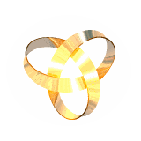
www.bangor.ac.uk/cpm/sculmath/movimm.htm

Slide 6
Hydrocephalus, an abnormal enlargement of the ventricles, places extraordinary demands on the stem cell population to provide adequate ependymal cell coverage of the ventricle surface.
… demands on … stem cell(s) … adequate coverage …
Spatiotemporal – 4D

Slide 7
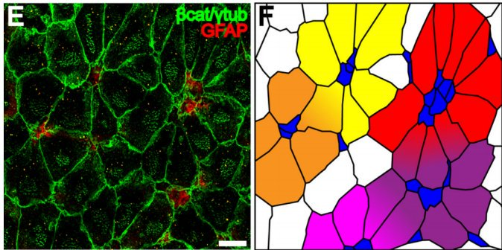
Image used with permission of author. Cover image.
Mirzadeh, Zaman, et al. "Neural stem cells confer unique pinwheel architecture to the ventricular surface in neurogenic regions of the adult brain." Cell stem cell 3.3 (2008): 265-278

Slide 15
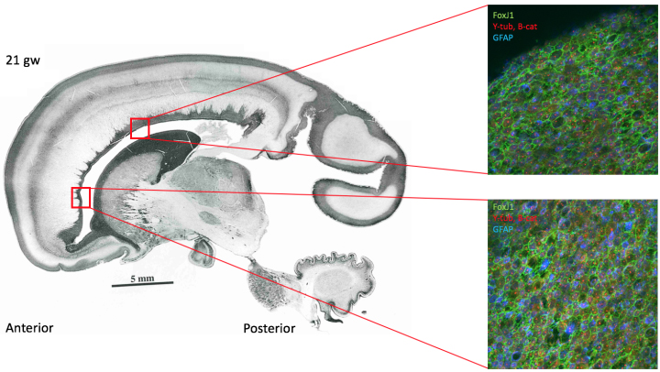

Slide 17
Progression to pin wheels
via blue cells, but
organization not yet obvious.

Slide 22
Joanne’s slides go here:
Atlas first
Flluorescent micorsope slides
Human edited pinwheels
Put two together
Note one at T0, another T1
What happens in between?
Math modeling, simulation.
Intervene in slico

Slide 23
Focus:
  Computational modeling and visualization of stem cell differentiation
  for clinical applications to hydrocephalus, both surgical and genetic.

Slide 24

Hub
Petals

Slide 25
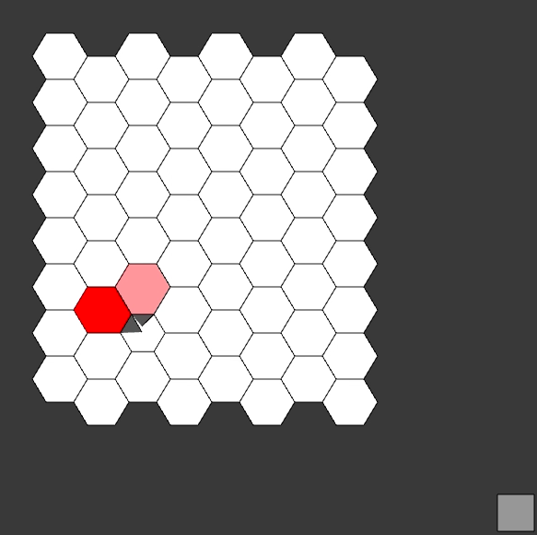
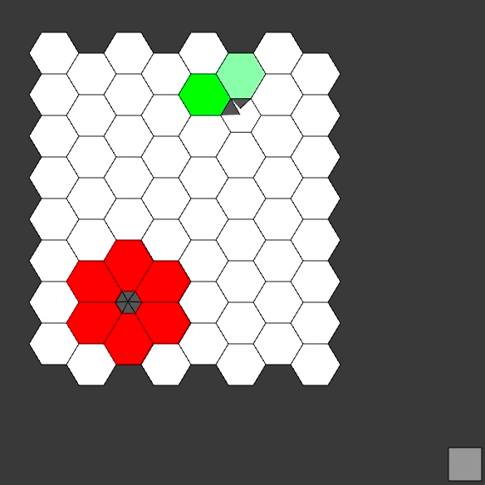

Slide 26
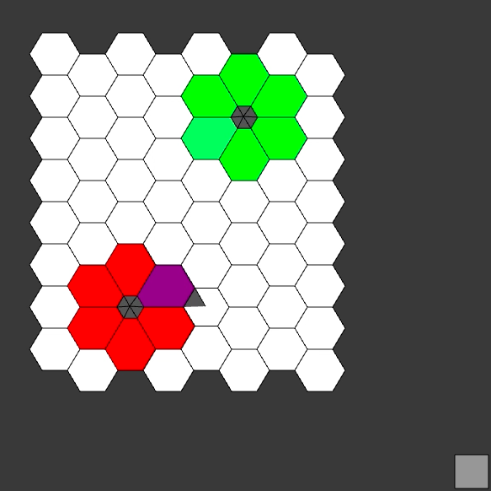
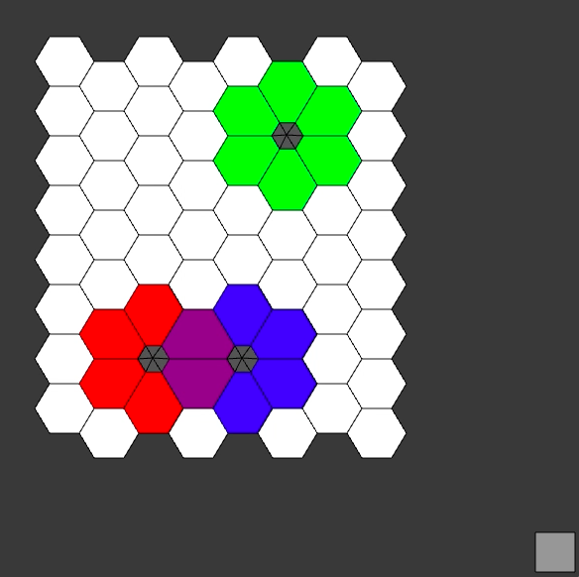

Slide 27
Demonstration of Interactive Prototype Tool.
(Pinwheel_Division)

Slide 28
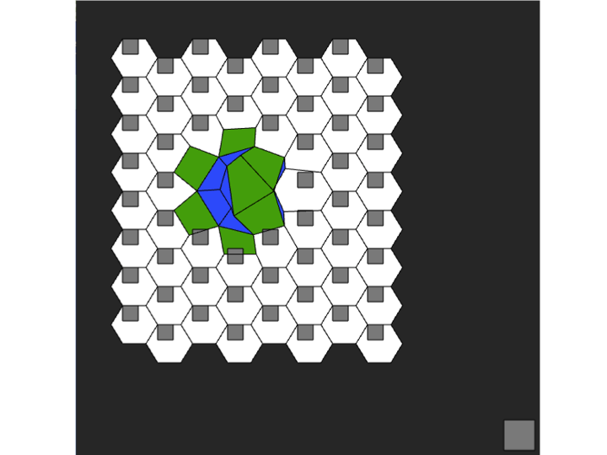

Slide 29
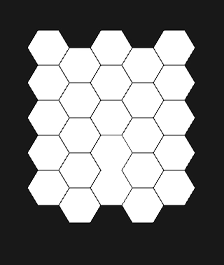

Slide 30
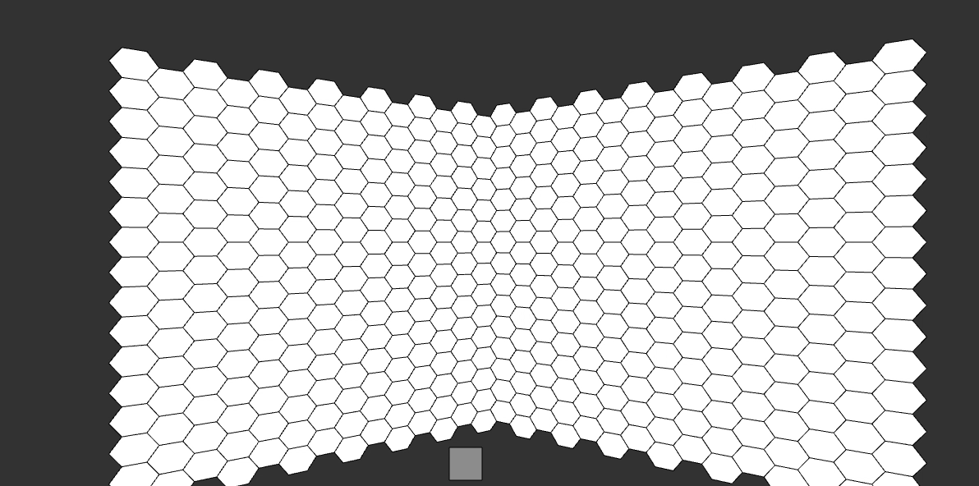

Slide 31
Interactive Prototype Tool
Geometric Combinatorics:
Disjoint
Intersecting
Hints to cell inhibition?
Sequence vs final outcome?

Slide 32
Transition to 3D:
Expansions/Contractions
Self-intersections
Slices & Reconstruction

Slide 33
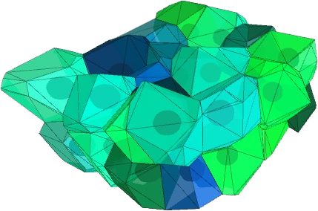

Slide 34
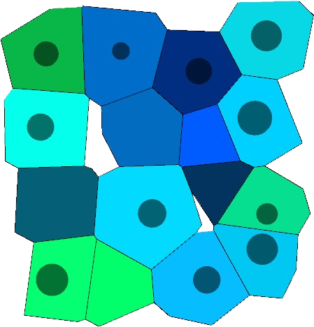

Slide 35
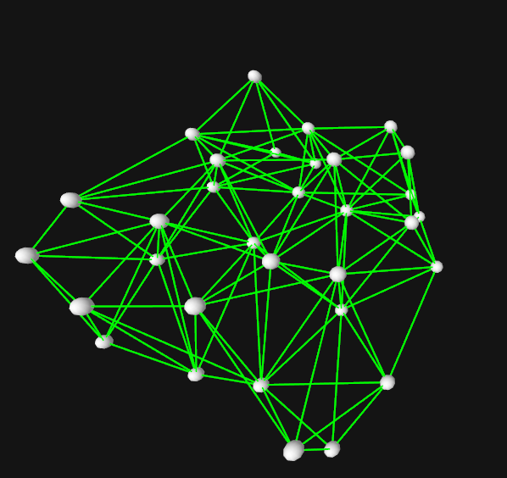
3D Locations of Nuclei Centers

Slide 36
Cyindrical Volume
Constant area in each slice sufficient.

Slide 37
Transition to 3D

Slide 38
Preserve Volume?
Constant area in each slice sufficient,
but
NOT necessary.

Slide 41
Distorting Shape while Preserving Volume (+)
F(x,y,z) to describe swept volume using splines.
F(x,y,z) by standard numeric approximation methods.
The unifying abstraction for volume V is
V = ∫ c (t) x F(x,y,z) dt, t ∈ [0,1],
for c: [0,1] è R³ , mapping into 3D

Slide 42
Digital topology
Show a 4 nbhd that is non-Hausdoof, and a 8-nbhc, extend

Slide 43
Digital topology
If D_{T} ((I, J), (I*, J*)) < 3, for distinct (I, J) & (I*, J*), then the geometric combinatorics are subtle.

Slide 46
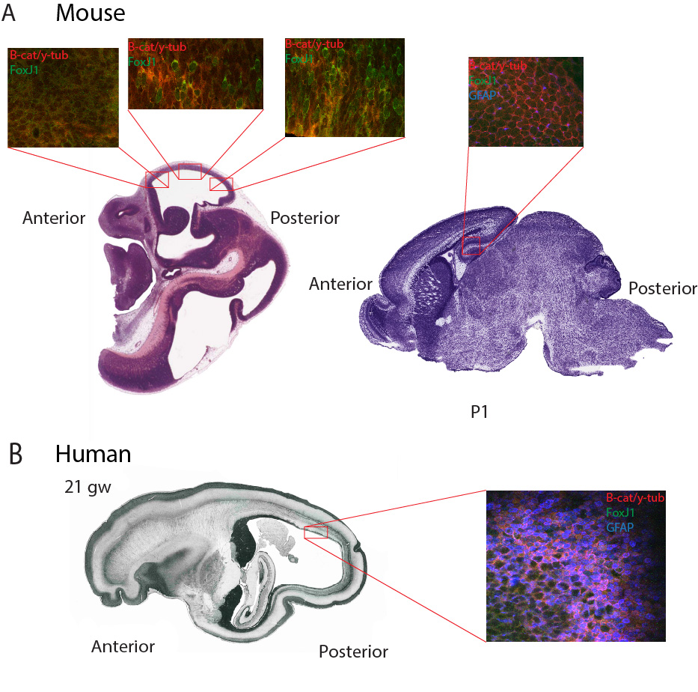
Fig. 2. Representative sections along the ventricle wall in mouse (A) and human (B) developmental sequences show cellular organization based on immunohistochemistry.

Slide 47
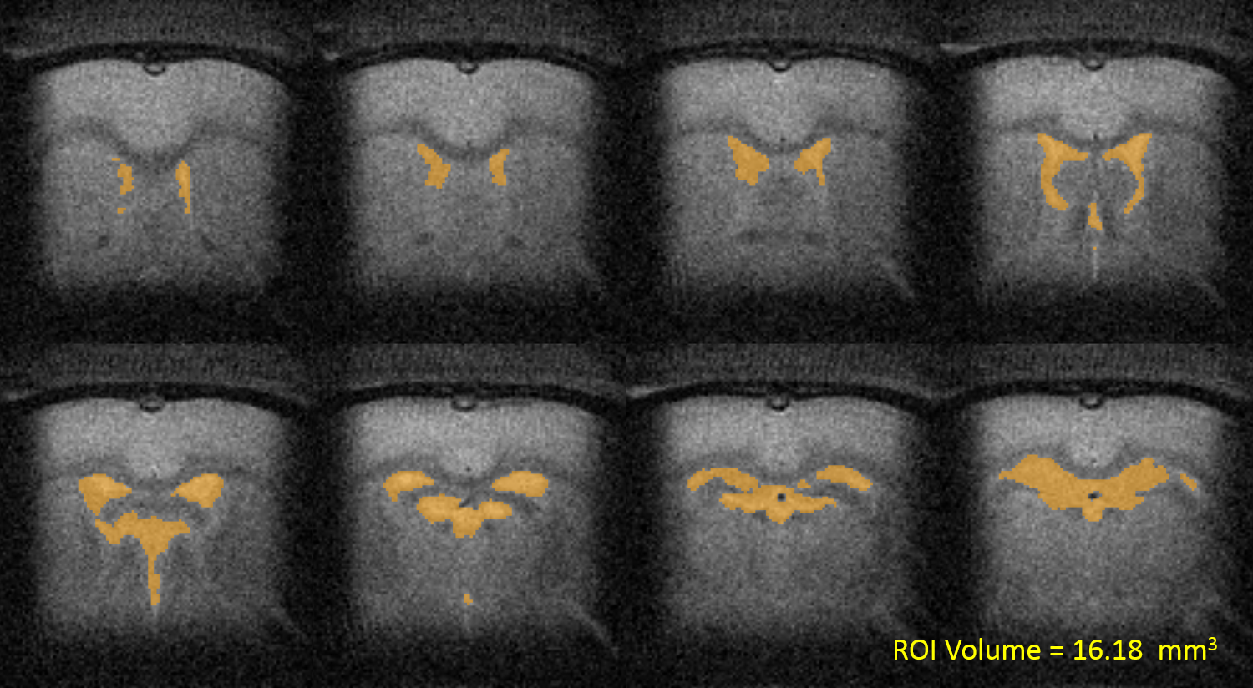
Sequential coronal MR images depicting the ventricular system in yellow from rat.

Slide 48
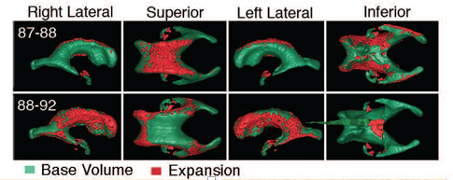
Longitudinal MR-based 3D reconstructions of human lateral ventricles showing areas of ventricle expansion and cellular changes at ventricle surface (red).

Slide 49
Deformations:
Cells & Inversion of Sphere
Kevin’s deformations
https://www.nytimes.com/video/science/100000003661279/inside-out-embryo.html

Slide 50
Raisin: shrivels up
Kevin’s deformations
Out1f: expand & contract
Stanford Bunny

Slide 53
Slices to 3D
Primary role for NIH Image
Possible Analyses with
MFB StereoInvestigator and NeuroLucida
Reduce to tractable geometric representation.

Slide 54
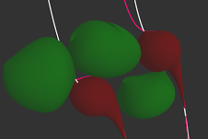
Morph Shapes
Preserve Volume
Dynamic Collission Detection

Slide 55
3D Locations of Nuclei Centers Landmarks

Slide 56
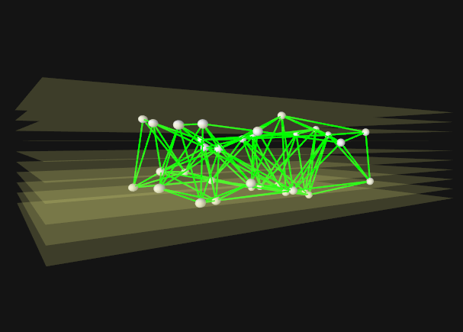

Slide 58
Grapes to Raisins
https://www.youtube.com/watch?v=uD_vhbv05aw#
Cell inversion
https://www.nytimes.com/video/science/100000003661279/inside-out-embryo.html
Vs
Inversion of sphere
https://www.youtube.com/watch?v=cdMLLmlS4Dc
Kevin’s spheres for us

Slide 59
a1: A sphere goes through a series of contractions and expansions. The coloring indicates the direction and magnitude of movement at each face. During the last contraction, the sphere passes through itself completely.
a2: A sphere goes through a series of contractions and expansions. Note the self intersections at the end of the animation.
a3: A sphere goes through a series of contractions and expansions. The smoothing distance used in this simulation was larger than in the previous two, resulting in less noise and more uniform movement.
a4: A bunny goes through a series of contractions and expansions. Self intersections occur again at the end of the animation. Note that the head and the neck of the bunny are the most effected by the deformations; this is due to the fact that the expansions and contractions occur with respect to a fixed point.

Slide 60
Thank you.

