Slide 1
Crystallizing Topology in Molecular Visualizations
Thomas J. Peters, Ph.D.
Professor of Computer Science and Engineering
Professor of Mathematics
Digital Media Center
with
T. Hunter, K. Marinelli, D. Marsh
University of Connecticut

Slide 2
Two Examples
Carbon freezing: high definition for insight
2. Macromolecular knotting
View to unify approaches to enhance discovery.

Slide 3

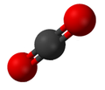

The Innovative Visualization Opportunity
Example: Carbon Freeze Zone (CFZ)
CARBON DIOXIDE - CO2
Notes:
3
3

Slide 4
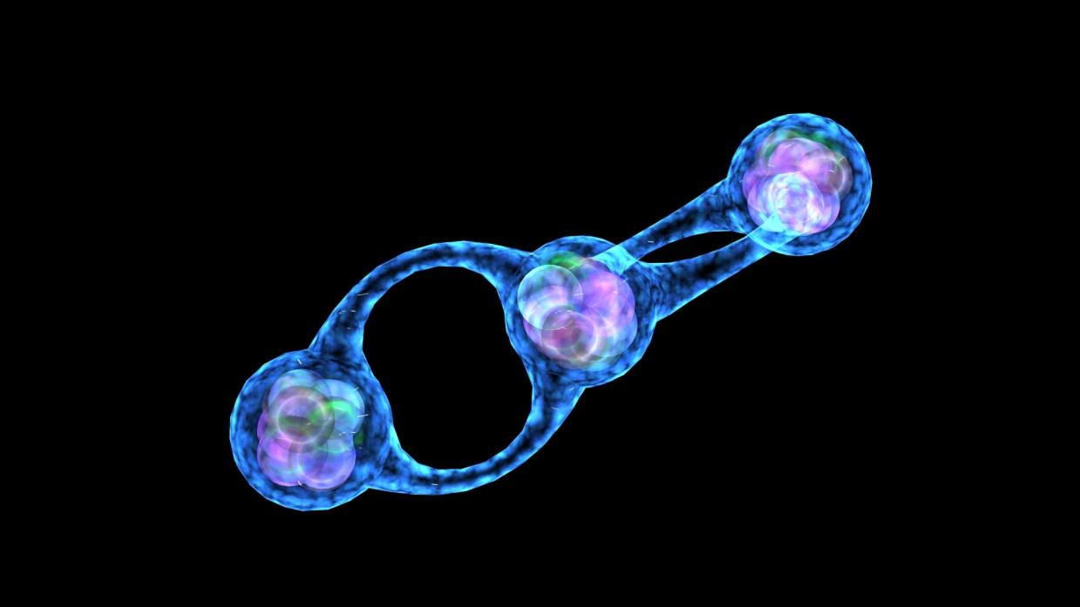
The Innovative Visualization Opportunity
CFZ - CARBON DIOXIDE - CO2
Excited State
Tim Hunter & ExxonMobil
Notes:
4
4

Slide 5
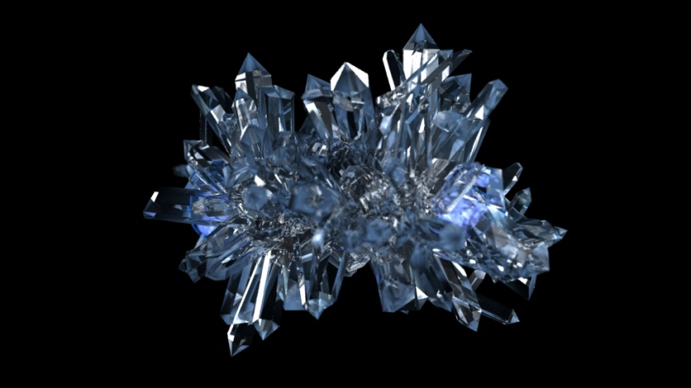
The Innovative Visualization Opportunity
CFZ - CARBON DIOXIDE - CO2
Frozen State
Tim Hunter & ExxonMobil
Notes:
5
5

Slide 6

The Interpolative Animation Process
CFZ - CARBON DIOXIDE - CO2
Tim Hunter & ExxonMobil
Notes:
6
6

Slide 7
The Innovative Visualization Opportunity
CFZ - CARBON DIOXIDE - CO2
Excited State
Frozen State
Tim Hunter & ExxonMobil
Notes:
7
7

Slide 8
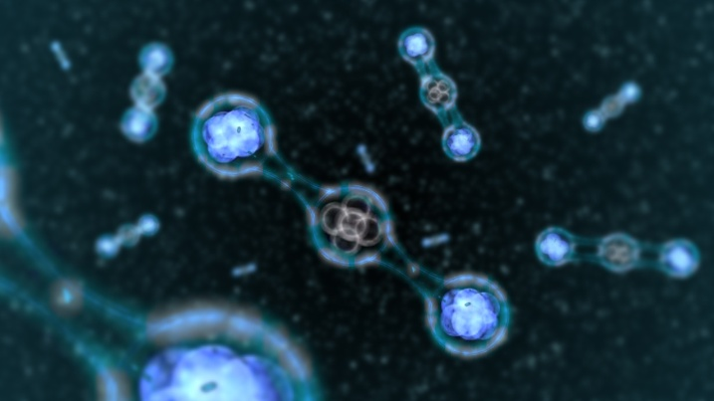
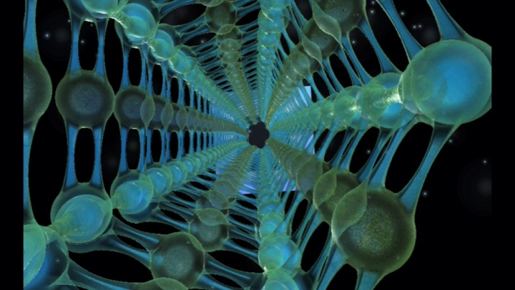
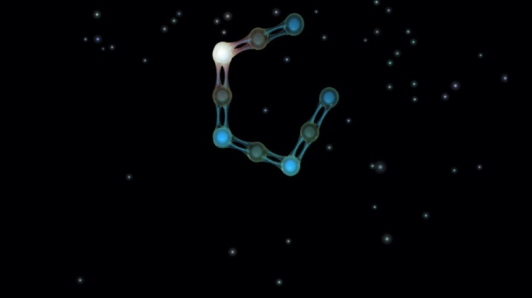
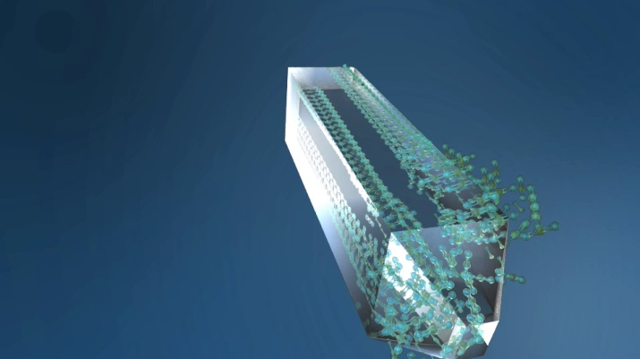
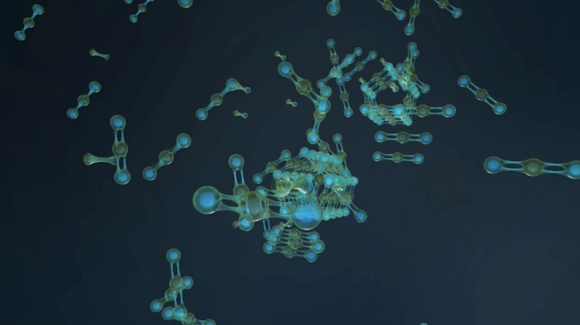
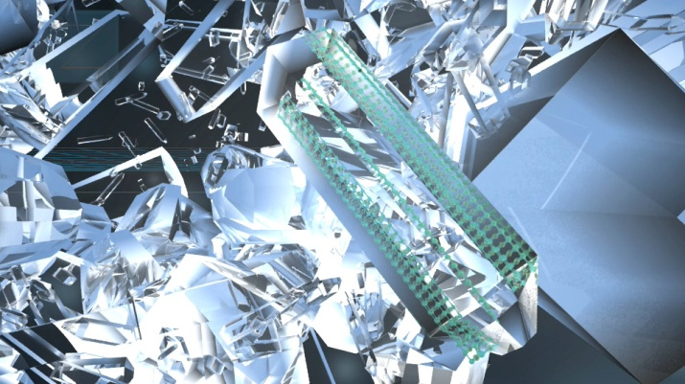
CFZ - CARBON DIOXIDE - CO2 - Formation
Tim Hunter & ExxonMobil
Notes:
8
8

Slide 9
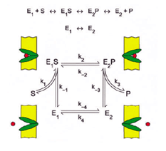
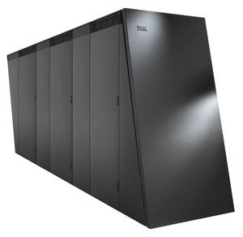
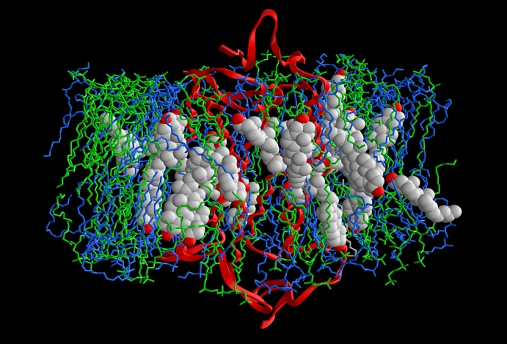
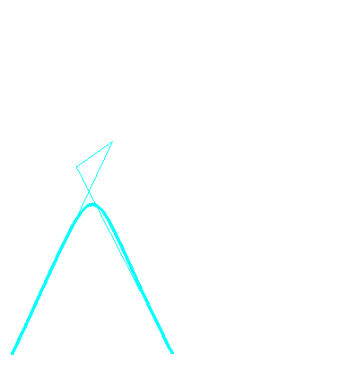
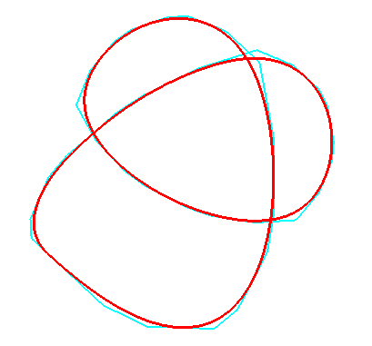
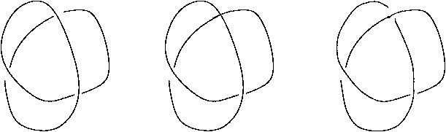
Time and Topology
Innovative Visualizations - InnoVIZ
Protein folding
Data Volume
Visualize in real time !
Geometry
--------
Versus
---------
Topology
Slow with errors
Fast & correct – but scale?
K. E. Jordan (IBM), L. E. Miller (UConn), E.L.F. Moore (UConn), T. J. Peters (UConn), A. C. Russell (UConn)
Notes:
9

Slide 10


Slide 11
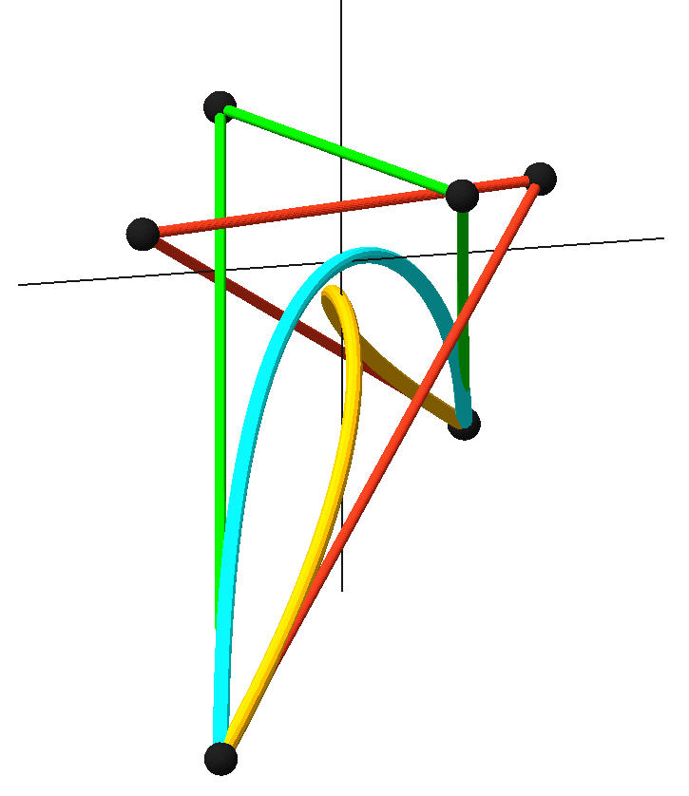
Crossings vs. symmetry & analysis.

Slide 12
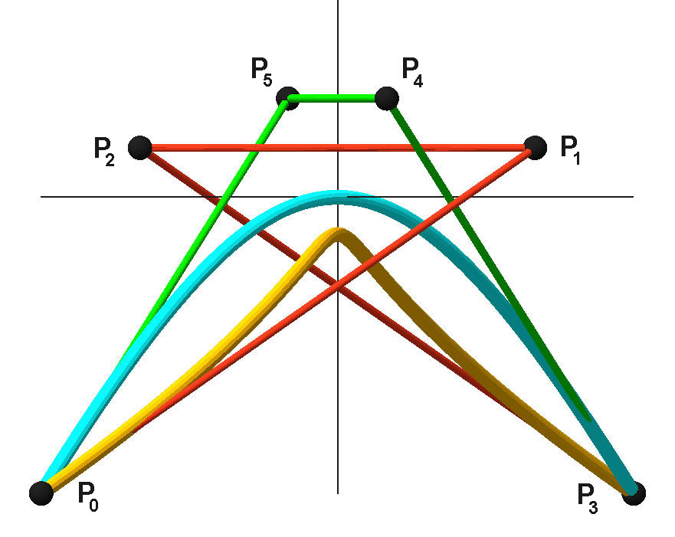
Bisceglio, Peters, Roulier, Sequin, CAGD 2011

Slide 13
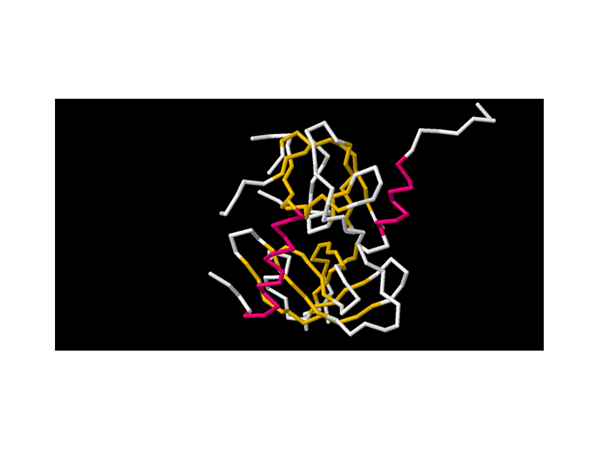

Slide 14
Ji Li -- Dissertation 2012 (?)
Sound theory for ambient isotopic PL approximation for Bezier curves of degree n.
Knot theory was key foundation.
High degree for `big’ molecules.
Now scale & accelerate.

Slide 15
Data Reduction
High degree for `big’ molecules.
10M atoms for items in PDB
Approximate by smooth curve, within user-supplied error bounds.

Slide 16
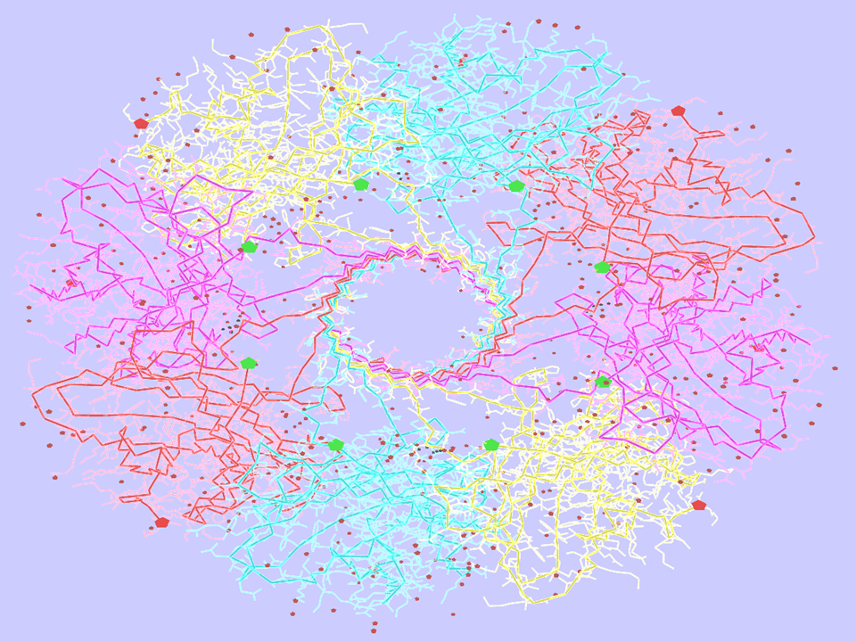

Slide 17

What is Digital Media?
Digital Media Alliance of Florida:
“The creative convergence of digital arts, science, technology and business for human expression, communication, social interaction and education”
New Digital Media Center at UConn
Notes:
17

Slide 18
Artifacts?
The Need for Verifiable Visualization
  Kirby and Silva, IEEE CG&A, 08
  What confidence (or error measures) can be assigned to a computer-based prediction of a complex event?
  CFD: colorful faulty dynamics
“Primarily, don’t introduce artifacts.”
Topology Verification for Isosurface Extraction, Etiene, T. Nonato, L., Scheidegger, C., Tierny, J., Peters, T., Pascucci, V., Kirby, R., Silva, C., IEEE, TVCG 2011

Slide 19
Acknowledgements:$$$
NSF EAGER, CMMI-1053077
NSF VR Lab & GOALI CMMI – 0923158.
NSF SBIR: TEA, IIP -0810023
NSF SGER: Computational Topology for Surface Approximation, FMM - 0429477.
IBM Faculty & Doctoral Awards & time.
Tim Hunter with ExxonMobil
Investigator’s responsibility, not sponsors’.

Slide 20
Acknowledgements: Images
www.knotplot.com
http://domino.research.ibm.com/comm/pr.nsf/pages/rscd.bluegene-picaa.html
www.bangor.ac.uk/cpm/sculmath/movimm.htm

